Slide 1

z
Program to generate assembly code from prefix code

Slide 2
1| Sazzad Hossen
ID: 2019-1-60-063
Group members
2| Sadab Jaowad
ID: 2019-1-60-082
3| Abdul Malek Sardar
ID: 2019-1-60-87

Slide 3
Outline
Introduction about infix, prefix & postfix
Steps of Infix to Prefix Conversion
Steps of Infix to Postfix Conversion
Code Demonstration
Success Rate of Conversion
Analysis of Time Complexity

Slide 4
Introduction
Infix: where operator are written between the operand.
Format: <operand><operator><operand>
Prefix: where operators are written ahead of operands
Format: <operator><operand><operand>
Postfix: where operators are written after operands
Format: <operand><operand><operator>

Slide 5
Introduction
Some Examples
SL. No | Infix | Prefix | Postfix
1. | (a + b) ∗ (c + d) | ∗ + a b + c d | a b + c d + ∗
2. | ((a + b) ∗ c) - d | - ∗ + a b c d | a b + c ∗ d -

Slide 6
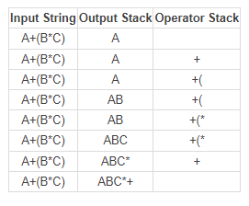
Steps of Infix to Postfix Conversion

Slide 7
Steps of Infix to Prefix Conversion
Step 1: Reverse the infix string. Note that while reversing the string you must interchange left and right parentheses.
Step 2: Obtain the postfix expression of the infix expression Step 1.
Step 3: Reverse the postfix expression to get the prefix expression

Slide 8
Code Demonstration

Slide 9
 | Infix | postfix | success | Prefix | success
1. | A*B+C*D | A B * C D*+ | 1 | +*A B * C D | 1
2. | (A+B)*(C+D) | AB+CD+* | 1 | *+AB+CD | 1
3. | A*B+C*D | AB*CD*+ | 1 | +*AB*CD | 1
4. | A+B+C+D | AB+C+D+ | 1 | +A+B+CD | 1
5. | A+B+C+(D*G)-9 | AB+C+DG*+9- | 1 | +A+B+C-*DG9 | 1
6. | (M-L*)+C+(D*G)-5+7 | ML*-C+DG*+5-7+ | 1 | +-M*L+C-*DG+57 | 1
7. | l*N-(P*Q)/R+L | lN*PQ*R/-L+ | 1 | -*lN+/*PQRL | 1
8. | l*N-(P*Q)/R+L*O-(D-S) | lN*PQ*R/-LO*+DS-- | 1 | -*lN+/*PQR-*LO-DS | 1
9 | A+(B*C)+((D+E*C)*F) | ABC*+DEC*+F*+ | 1 | +A+*BC*+D*ECF | 1
10. | a+(c*f-d)*e+bc+(q-r/g) | acf*d-e*+bc+qrg/-+ | 1 | +a+*-*cfde+bc-q/rg | 1
11. | Q/R+(c*f-d)*e+b*c+ | QR/cf*d-e*+bc*++ | 1 | +/QR+*-*cfde+*bc | 1
12. | P^Q^L-9+8*7-U*V | PQ^L^9-87*+UV*- | | 1 | -^P^QL+9-*87*UV | 1
13. | J-l+(K*D)-2+4-f^g | Jl-KD*+2-4+fg^- | 1 | -J+l-*KD+2-4^fg | 1
14 | 9*8-3^9-(((9*7)*4)/3) | 98*39^-97*4*3/- | 1 | -*98-^39/**9743 | 1
15. | (p^q)-9*8-3^9-(((9*7)*4)/3) | pq^98*-39^-97*4*3/- | 1 | -^pq-*98-^39/**9743 | 1
Success Rate of Code

Slide 10
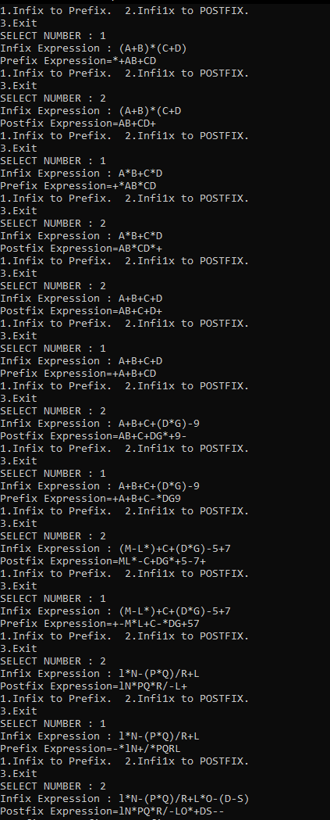
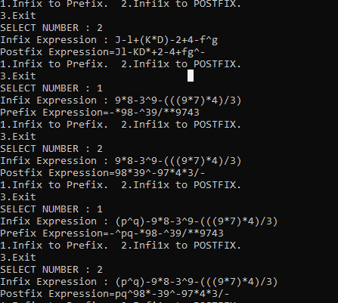
Success Rate of Code

Slide 11
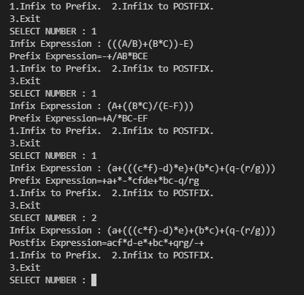
Success Rate of Code
REFERENCES :
https://www.web4college.com/converters/infix-to-postfix-prefix.php
https://raj457036.github.io/Simple-Tools/prefixAndPostfixConvertor.html

Slide 12
Analysis of Time Complexity
Stack operations like push() and pop() are performed in constant time. Since we scan all the characters in the expression once the complexity in linear in time O(n).

Slide 13
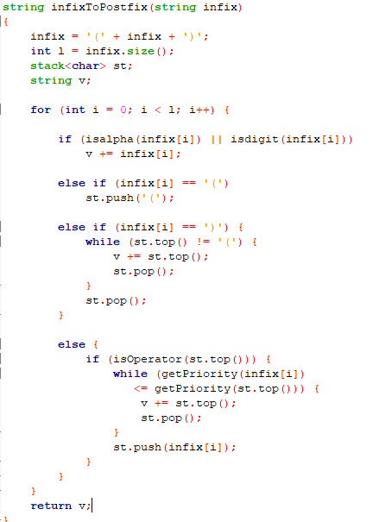
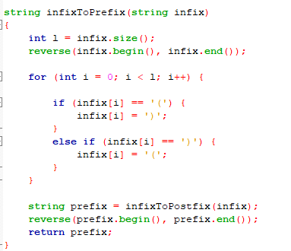
Analysis of Time Complexity
O(n)
O(n)

Slide 14
THANKS
FOR YOUR UTTER PATIENCE

